Slide 1
How long can the tree of life survive man?
“tree of life” googled

Slide 2
56 afbeeldingen
uit
https://www.google.be/search?hl=nl&site=imghp&tbm=isch&source=hp&biw=1600&bih=726&q=tree+of+life&oq=tree+of+life&gs_l=img.12..0l10.1241.3837.0.5061.12.9.0.3.3.0.133.912.5j4.9.0...0.0...1ac.1.14.img.RsAnlDpEeMA
and some other websites
(24 mei 2013)
en 1 vraag
duur: 4 min.

Slide 3
How long can the tree of life survive man?

Slide 4
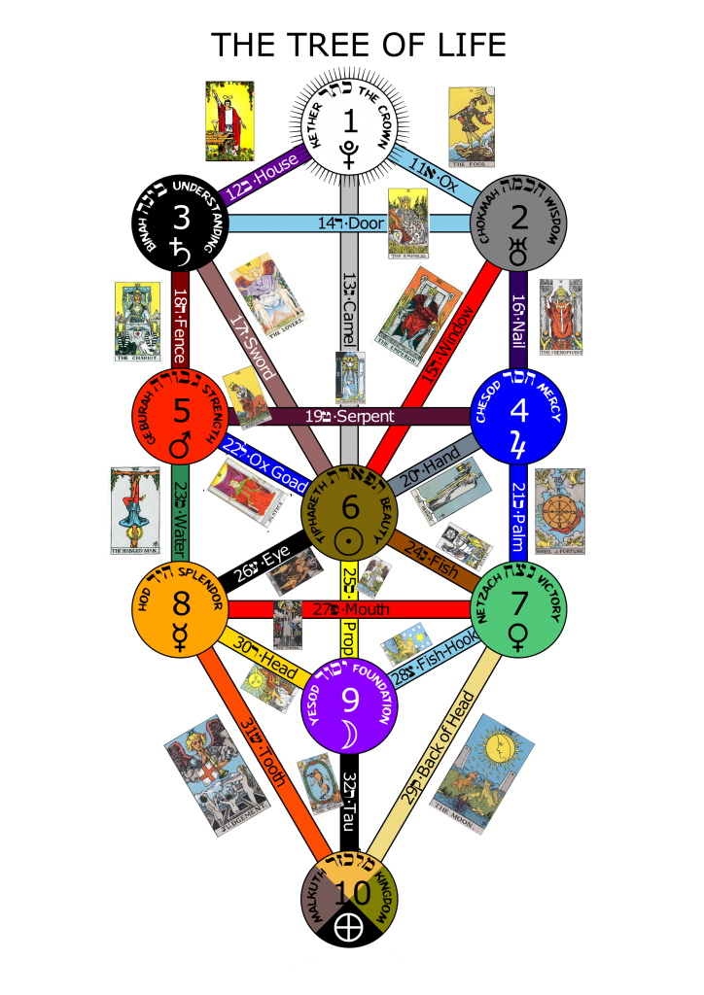
How long can the tree of life survive man?

Slide 5
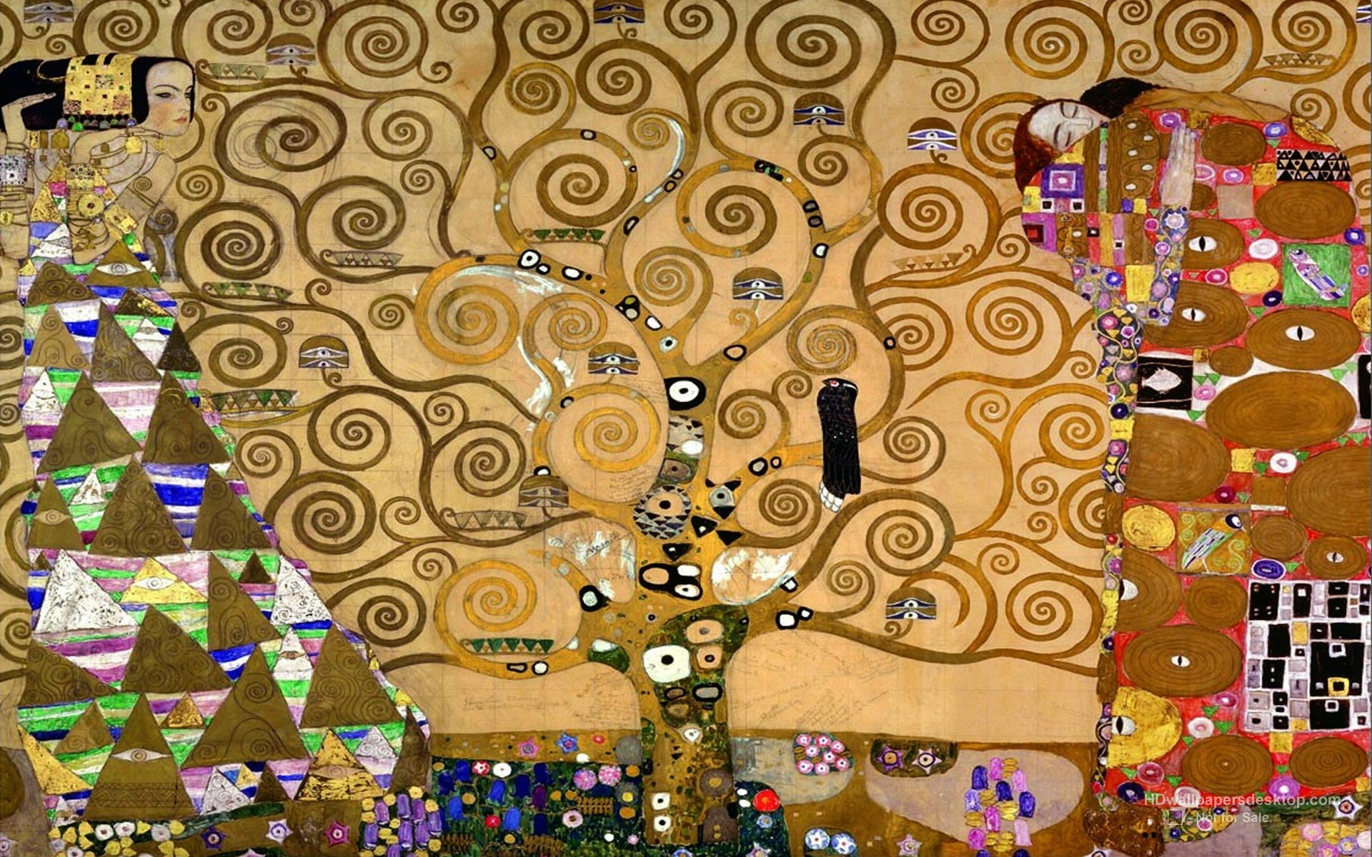
How long can the tree of life survive man?

Slide 6
How long can the tree of life survive man?

Slide 7
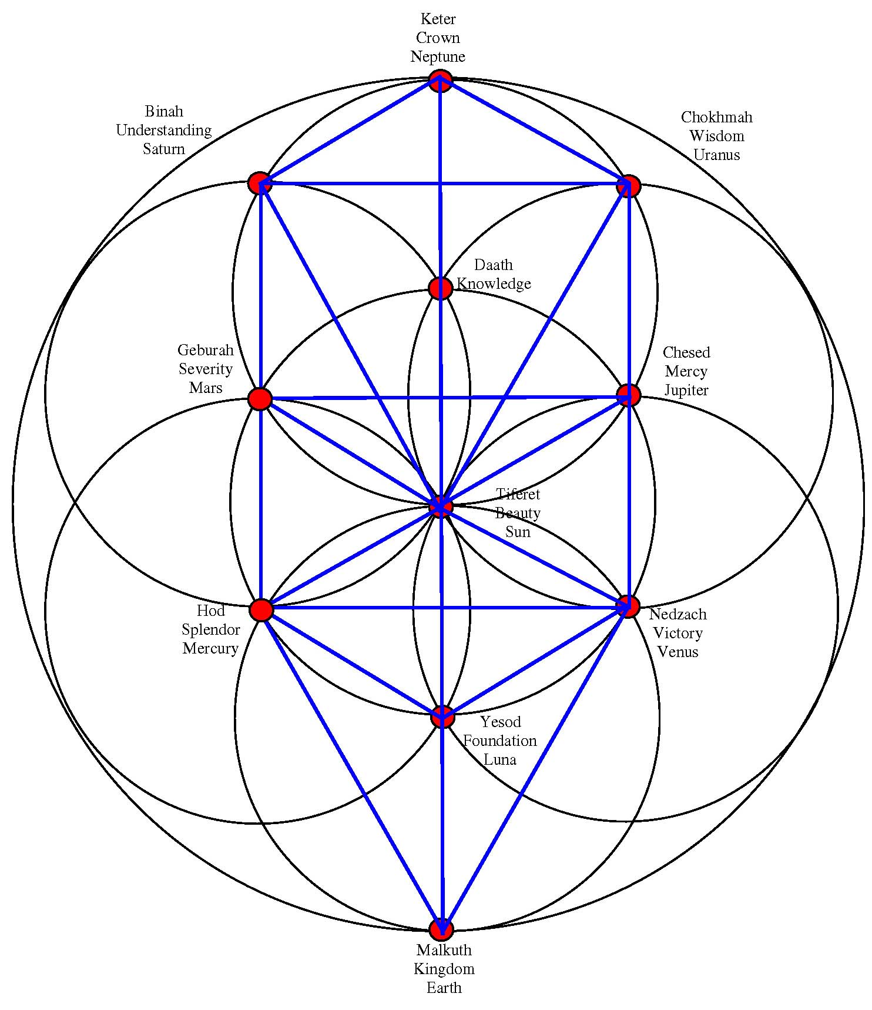
How long can the tree of life survive man?

Slide 8
How long can the tree of life survive man?

Slide 9
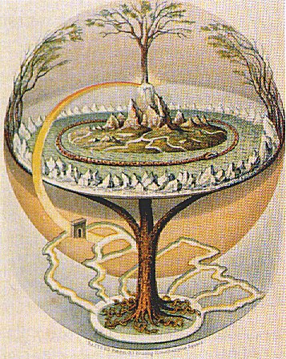
How long can the tree of life survive man?

Slide 10
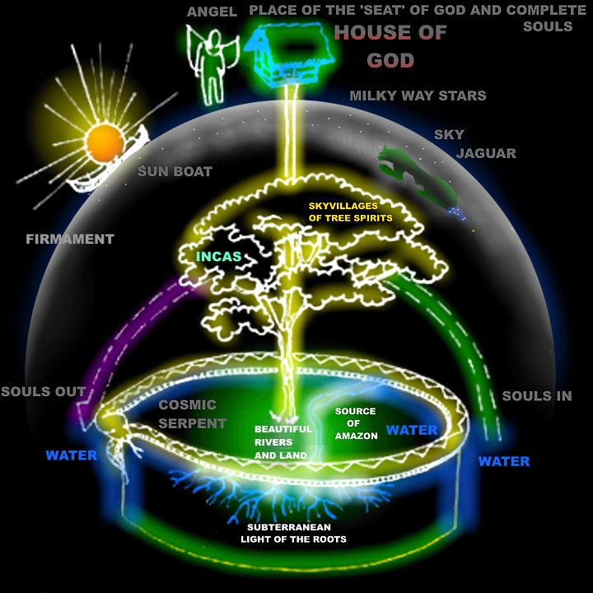
How long can the tree of life survive man?

Slide 11
How long can the tree of life survive man?

Slide 12
How long can the tree of life survive man?

Slide 13
How long can the tree of life survive man?

Slide 14
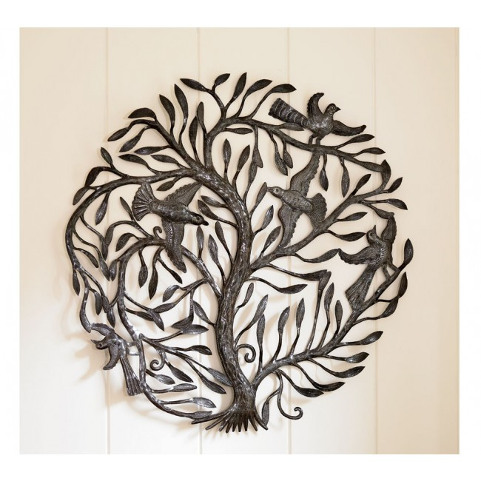
How long can the tree of life survive man?

Slide 15
How long can the tree of life survive man?

Slide 16
How long can the tree of life survive man?

Slide 17
How long can the tree of life survive man?
T

Slide 18
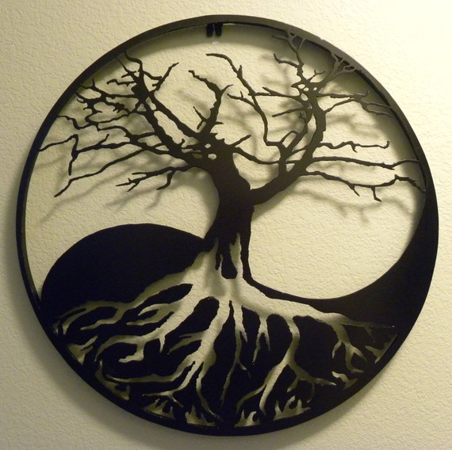
How long can the tree of life survive man?

Slide 19
How long can the tree of life survive man?

Slide 20
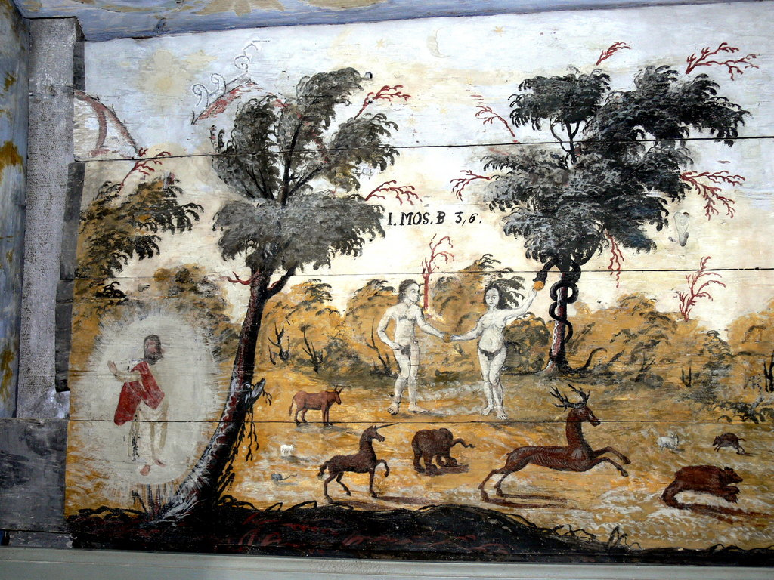
How long can the tree of life survive man?

Slide 21
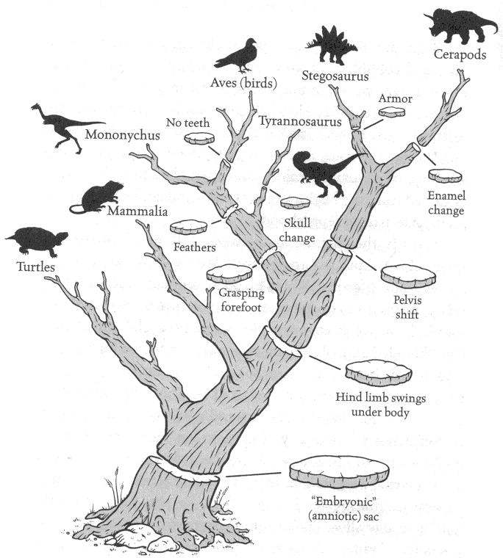
How long can the tree of life survive man?

Slide 22
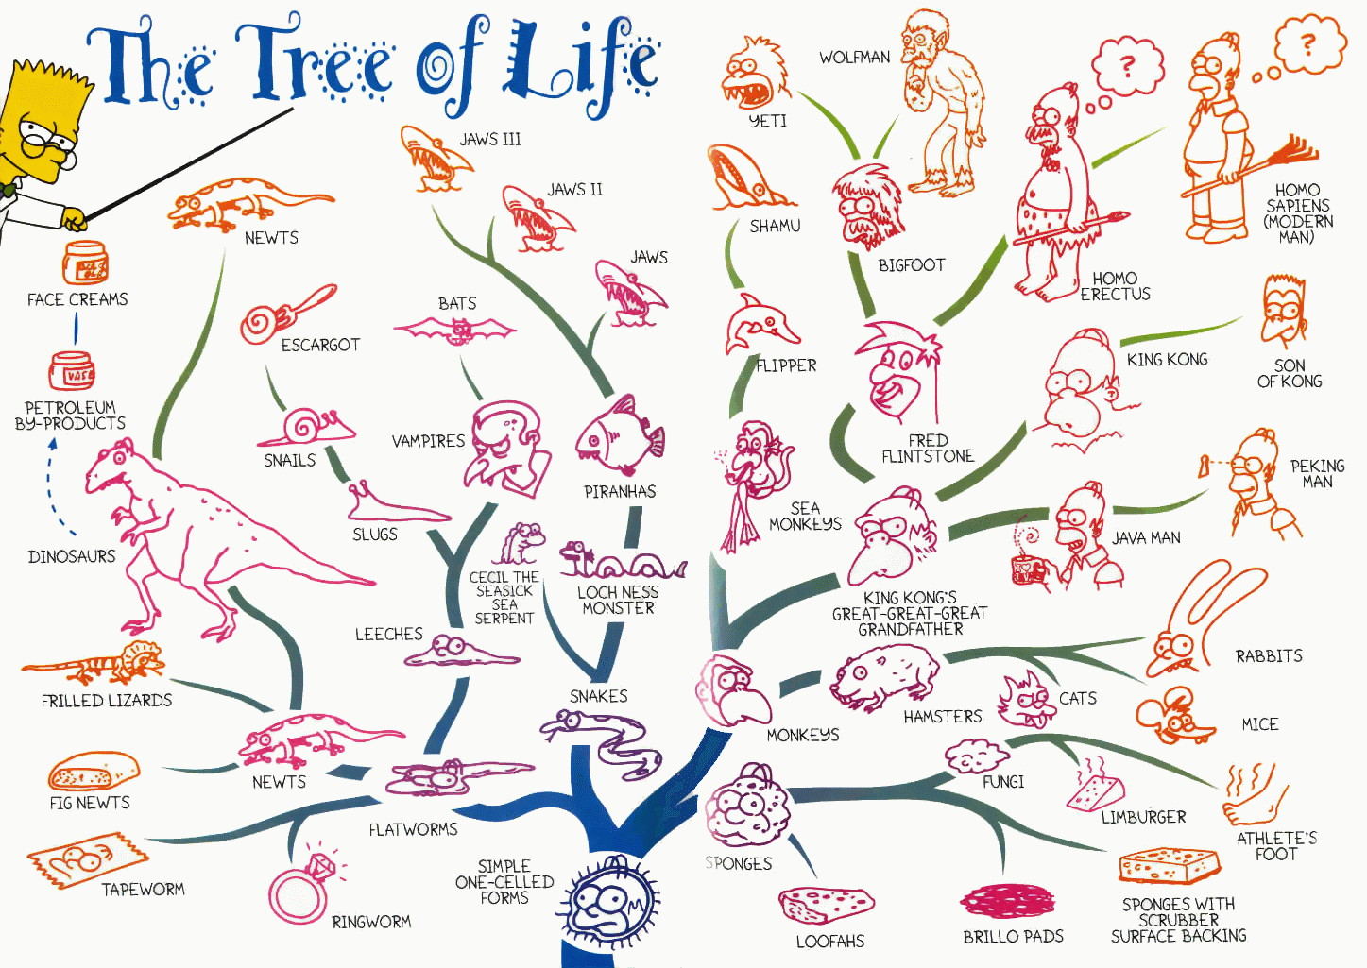
How long can the tree of life survive man?

Slide 23
How long can the tree of life survive man?

Slide 24
How long can the tree of life survive man?

Slide 25
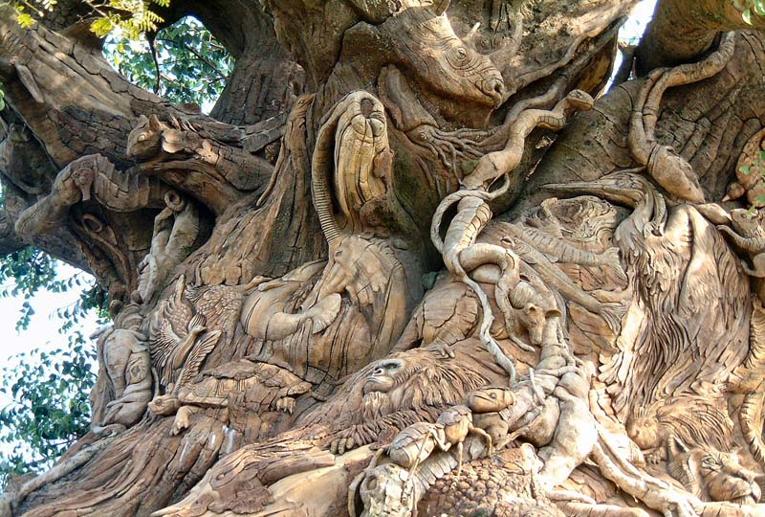
How long can the tree of life survive man?

Slide 26
How long can the tree of life survive man?

Slide 27
How long can the tree of life survive man?

Slide 28
How long can the tree of life survive man?

Slide 29
How long can the tree of life survive man?

Slide 30
How long can the tree of life survive man?

Slide 31
How long can the tree of life survive man?

Slide 32
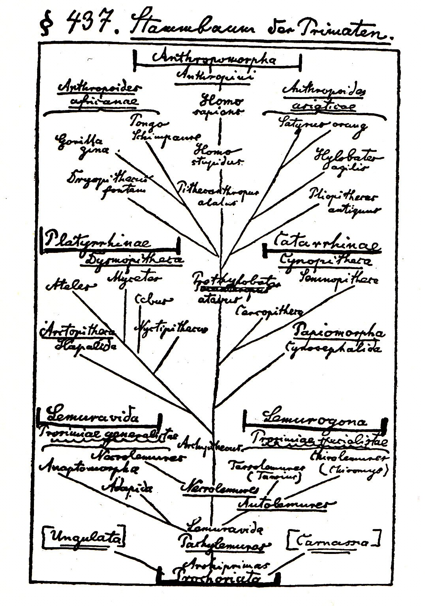
How long can the tree of life survive man?

Slide 33
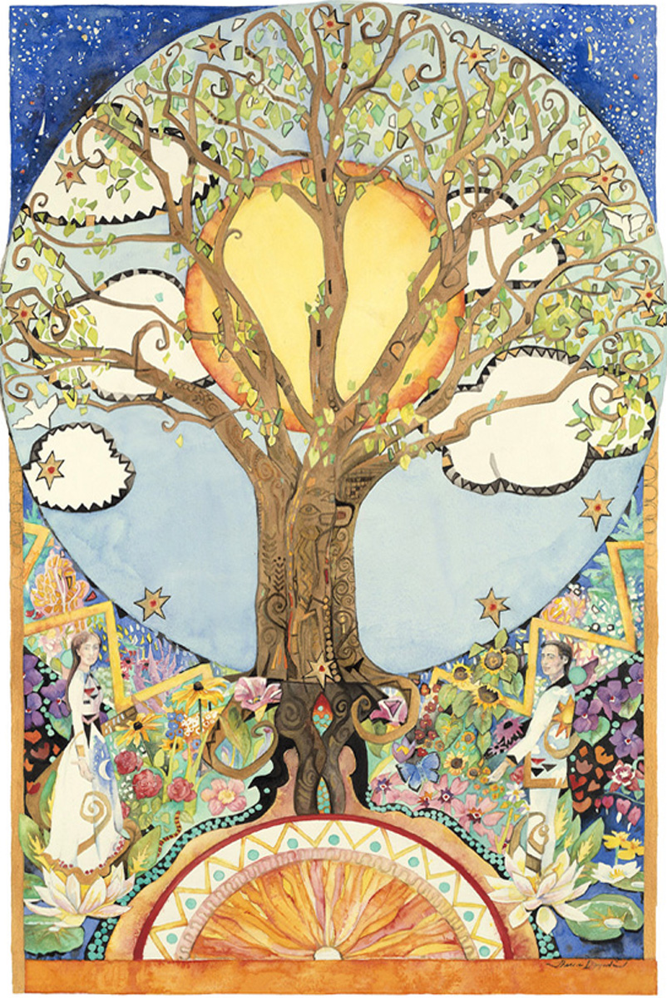
How long can the tree of life survive man?

Slide 34
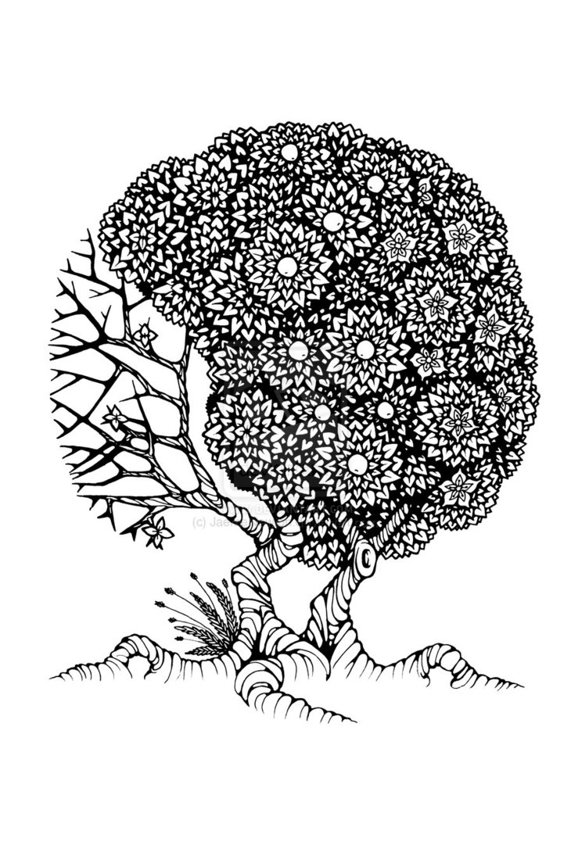
How long can the tree of life survive man?

Slide 35
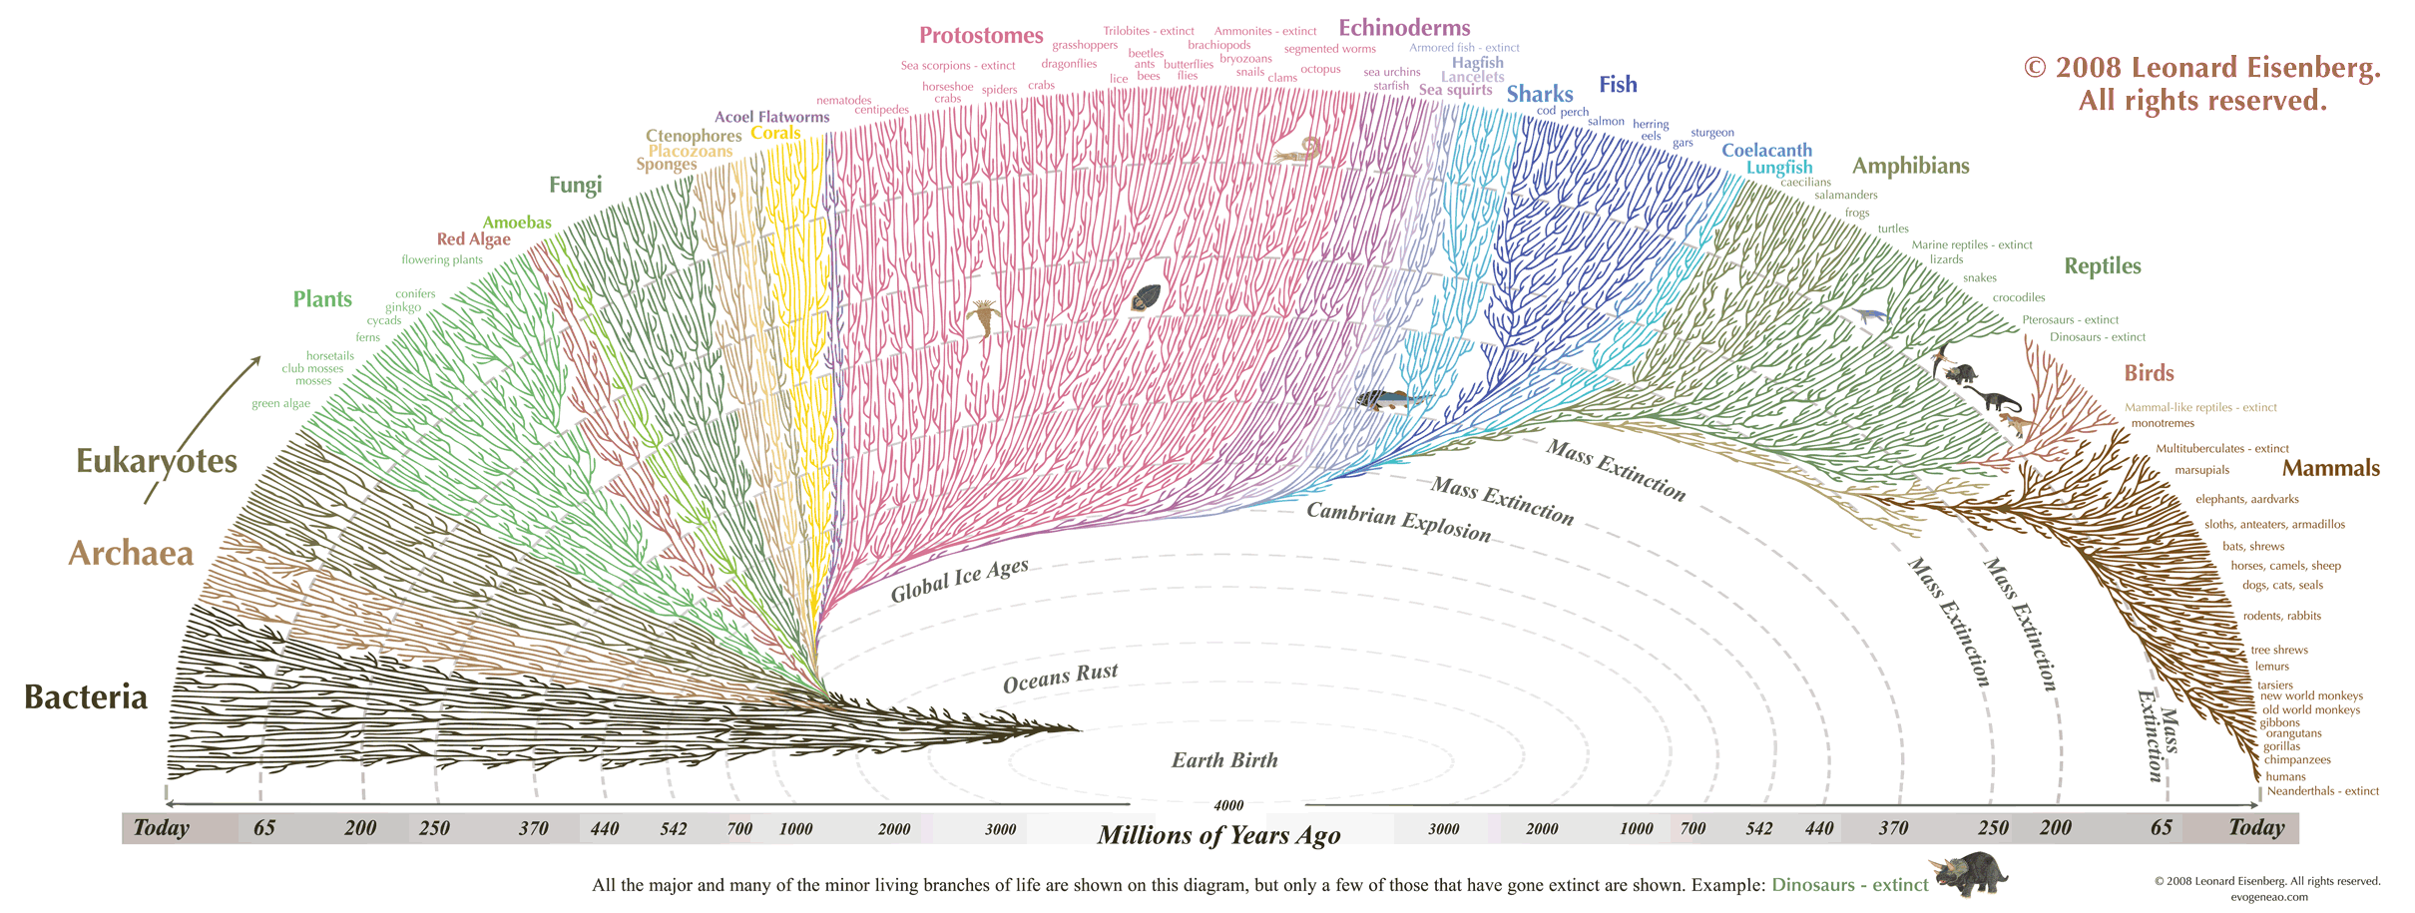
How long can the tree of life survive man?

Slide 36
How long can the tree of life survive man?

Slide 37
How long can the tree of life survive man?

Slide 38
How long can the tree of life survive man?

Slide 39
How long can the tree of life survive man?

Slide 40
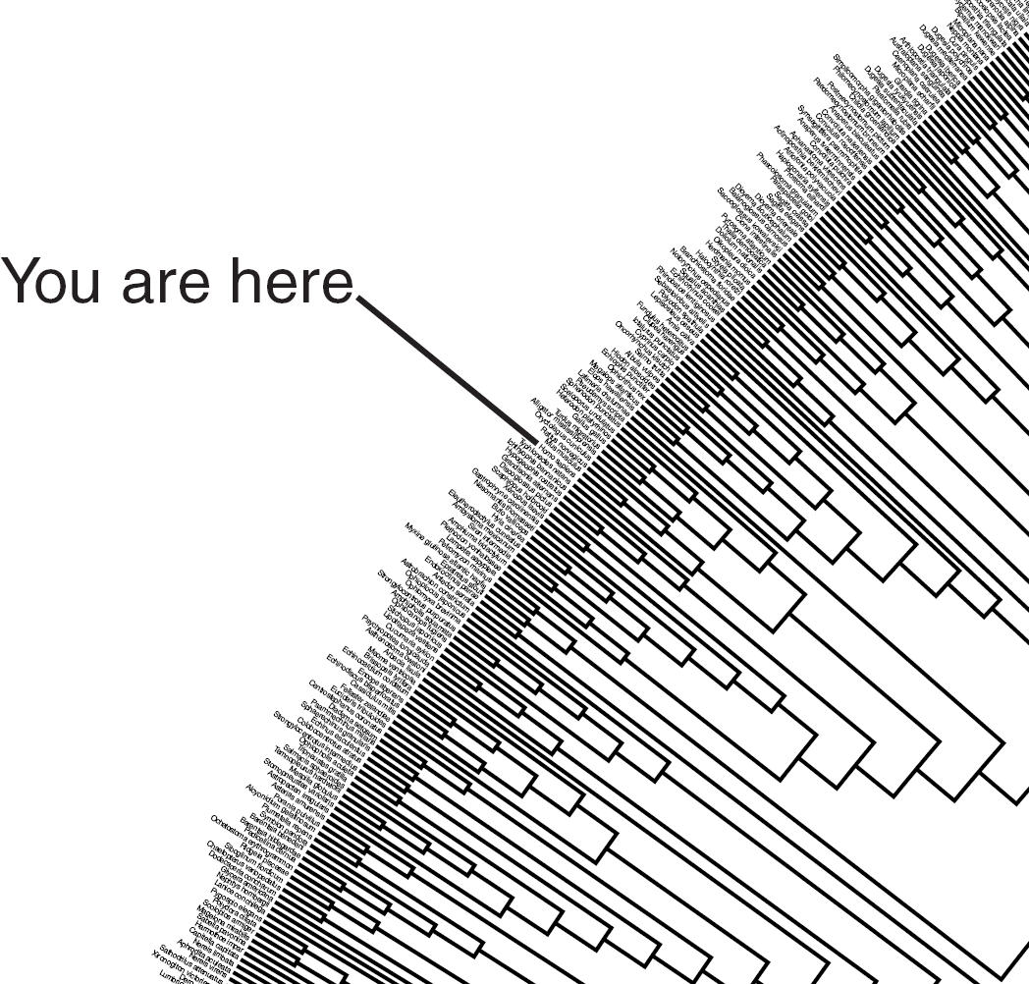
How long can the tree of life survive man?

Slide 41
How long can the tree of life survive man?

Slide 42
How long can the tree of life survive man?

Slide 43
How long can the tree of life survive man?

Slide 44
How long can the tree of life survive man?

Slide 45
How long can the tree of life survive man?

Slide 46
How long can the tree of life survive man?

Slide 47
How long can the tree of life survive man?

Slide 48
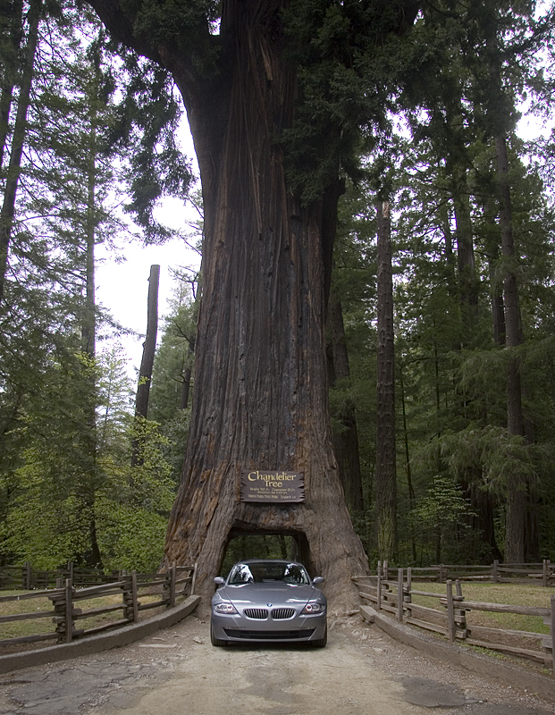
How long can the tree of life survive man?

Slide 49
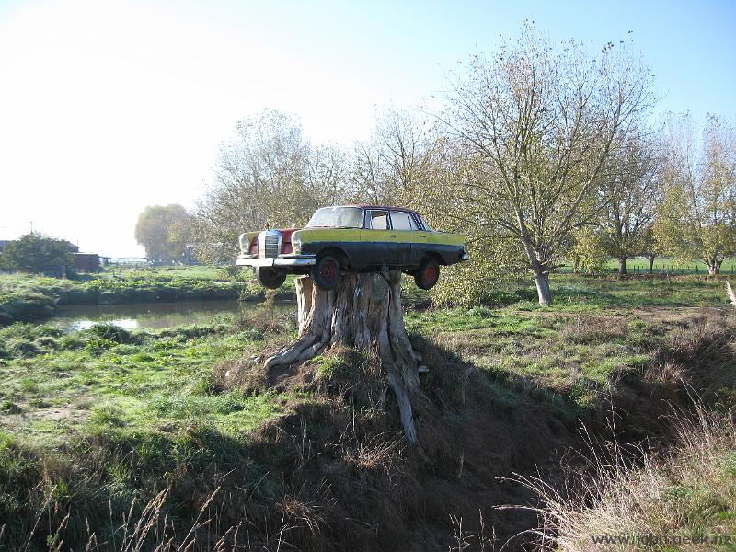
How long can the tree of life survive man?

Slide 50
How long can the tree of life survive man?

Slide 51
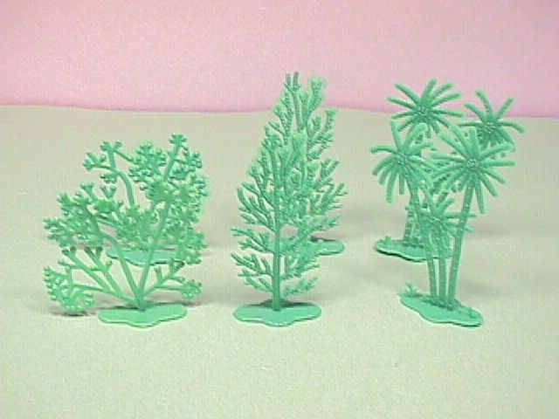
How long can the tree of life survive man?

Slide 52
How long can the tree of life survive man?

Slide 53
How long can the tree of life survive man?

Slide 54
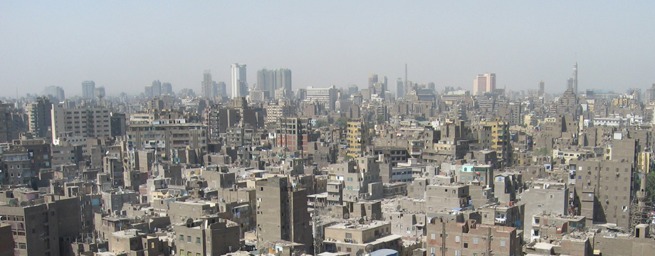
How long can the tree of life survive man?

Slide 55
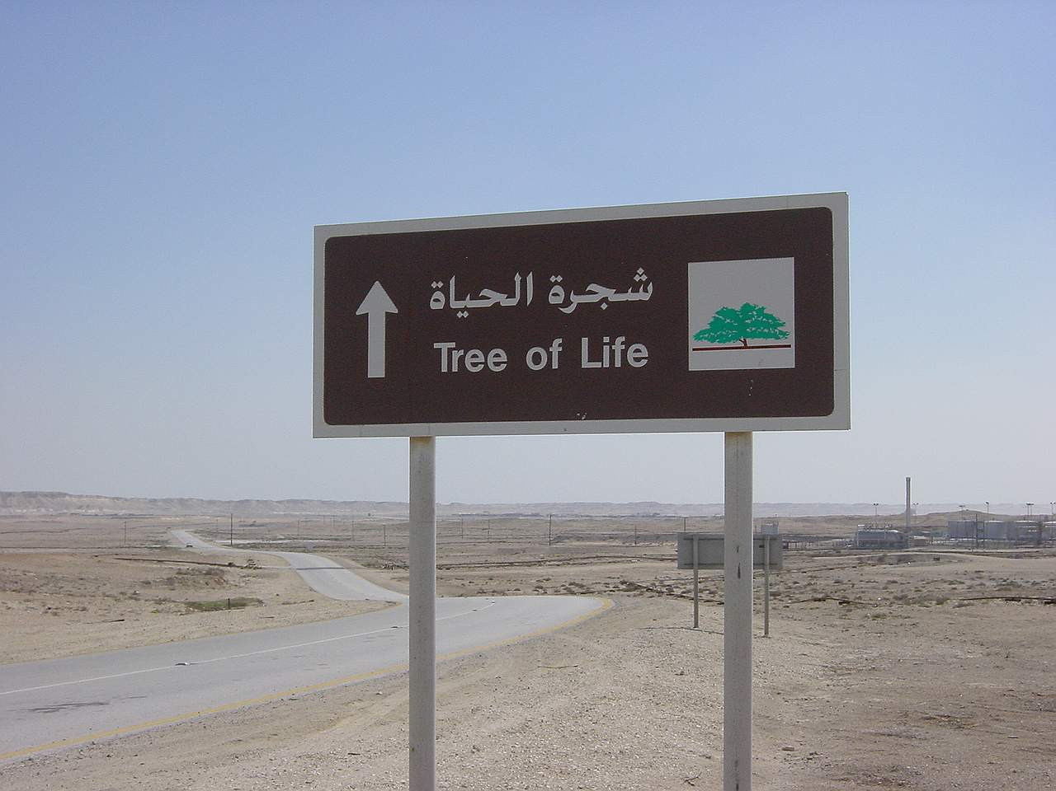
How long can the tree of life survive man?

Slide 56
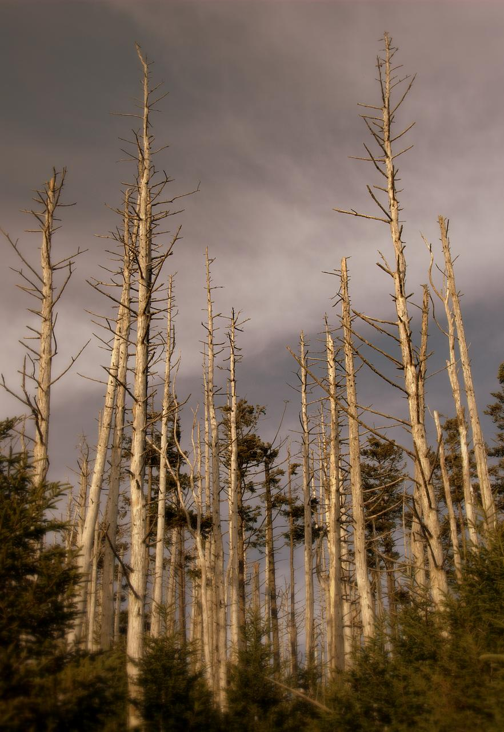
How long can the tree of life survive man?

Slide 57
How long can the tree of life survive man?

Slide 58
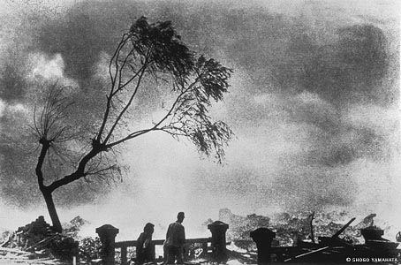
How long can the tree of life survive man?

Slide 59
How long can the tree of life survive man?

Slide 60
How long can the tree of life survive man?

Slide 61
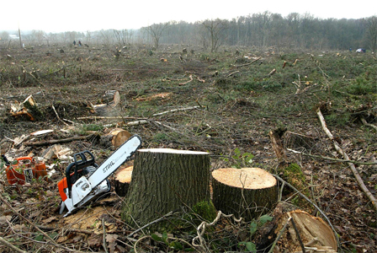
How long can the tree of life survive man?

Slide 62
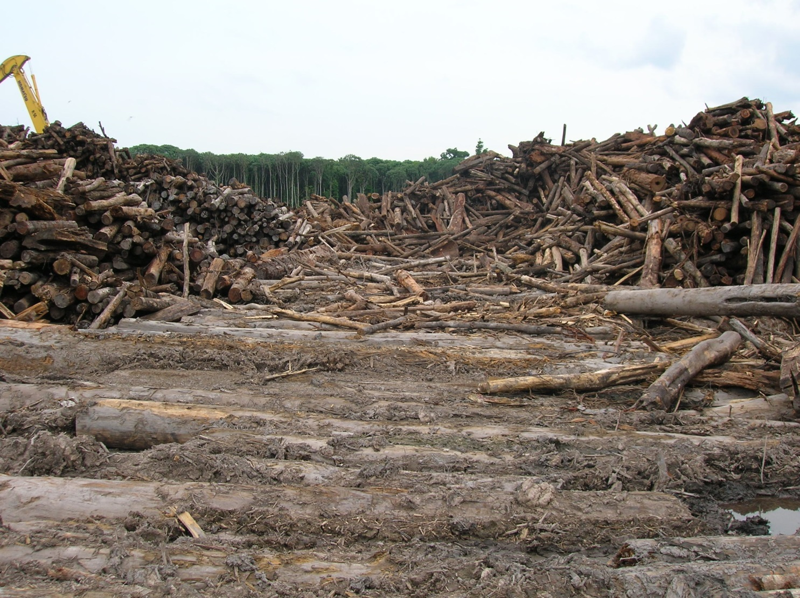
How long can the tree of life survive man?

Slide 63
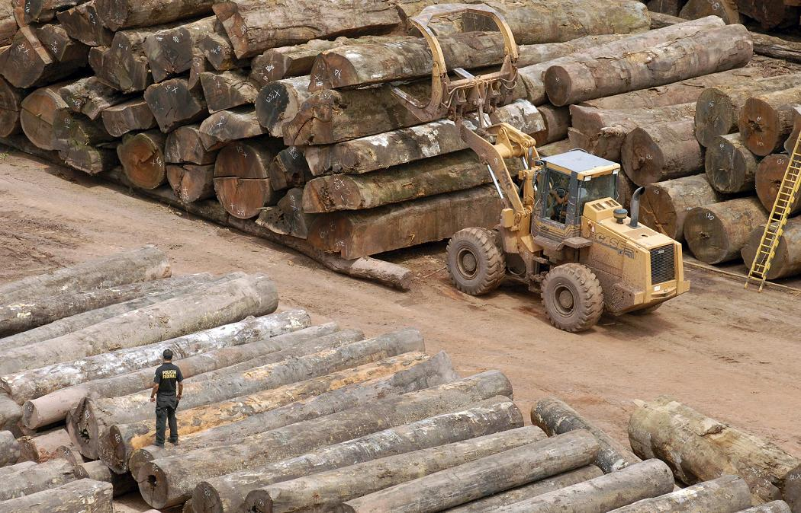
How long can the tree of life survive man?

Slide 64
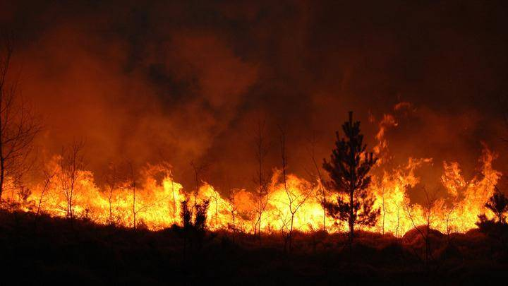
How long can the tree of life survive man?

Slide 65
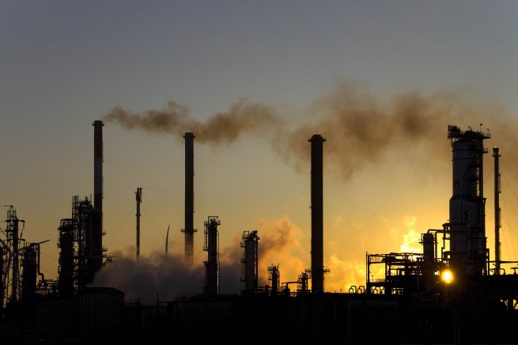
How long can the tree of life survive man?

Slide 66
How long can the tree of life survive man?

Slide 67
How long can the tree of life survive man?

