Slide 1
What’s wrong with…
“colourful people”
googled
(16-12-2011)

Slide 2
46 photos
taken from
http://www.google.be/search?q=colourful+people&rls=com.microsoft:nl-be:IE-SearchBox&oe=UTF-8&redir_esc=&um=1&ie=UTF-8&hl=nl&tbm=isch&source=og&sa=N&tab=wi&ei=LCnrTteRGoGfOqjHgKMI&biw=1440&bih=733&sei=MCnrTuGqFYiUOpnbsJQI
(the first 10 pages)
and 1 question
by Paul Gordyn
duration: 9 min.

Slide 3
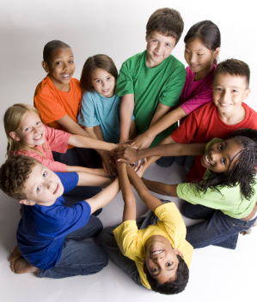
What’s wrong with
the boy with the blue t-shirt?

Slide 4
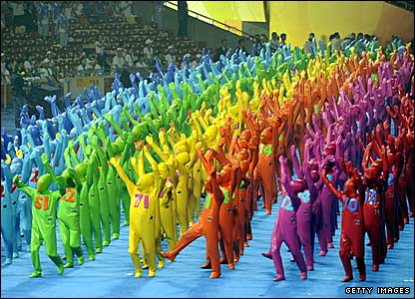
What’s wrong with
nr. 94?

Slide 5
What’s wrong with
the second figure from the left above?

Slide 6
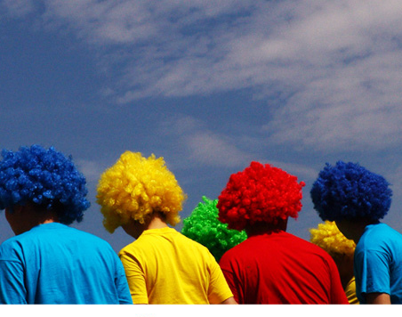
What’s wrong with
the girl with the green hair?

Slide 7
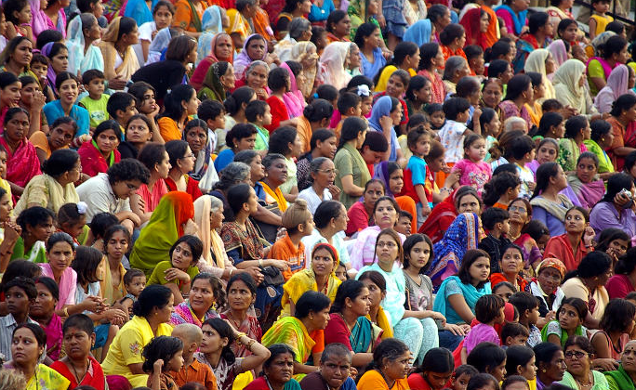
What’s wrong with
the woman in the middle wearing a yellow shawl and sitting next to a woman with glasses?

Slide 8
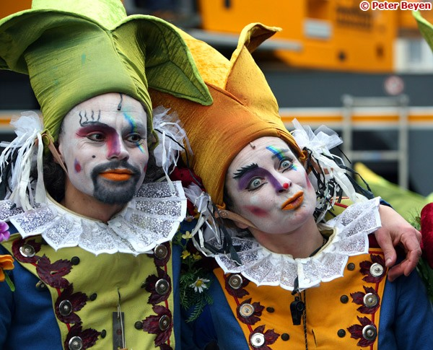
What’s wrong with
the man on the left?

Slide 9
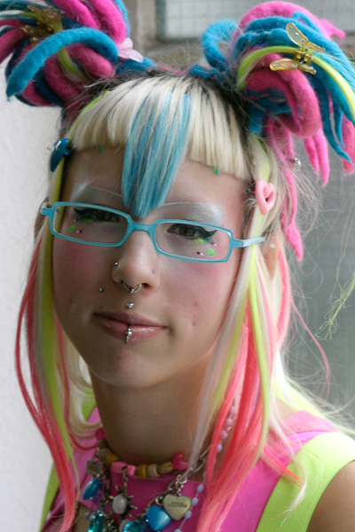
What’s wrong with
the girl?

Slide 10
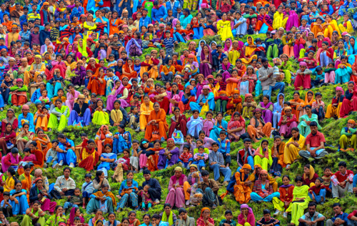
What’s wrong with
the boy in the right corner at the bottom?

Slide 11
What’s wrong with
the woman?

Slide 12
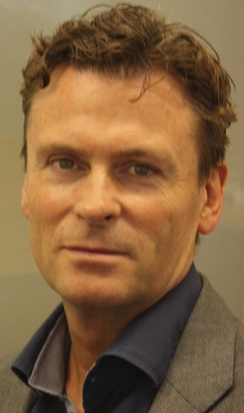
What’s wrong with
the man?

Slide 13
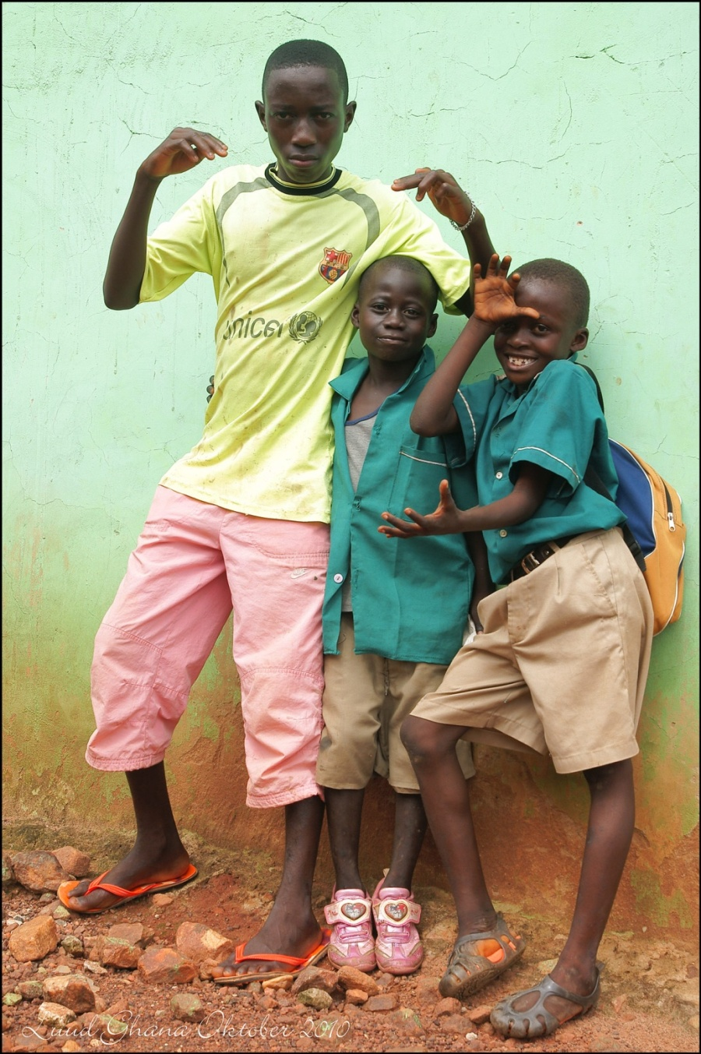
What’s wrong with
the boy with the pink shoes?

Slide 14
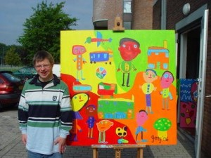
What’s wrong with
the young man?

Slide 15
What’s wrong with
the woman?

Slide 16
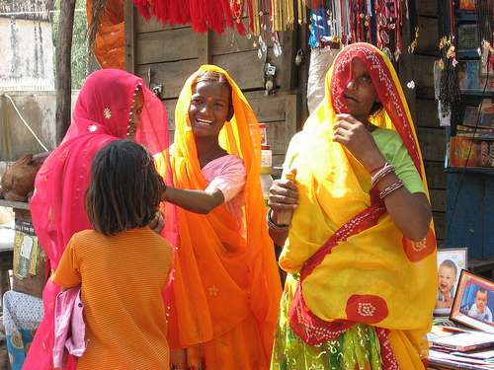
What’s wrong with
the little girl?

Slide 17
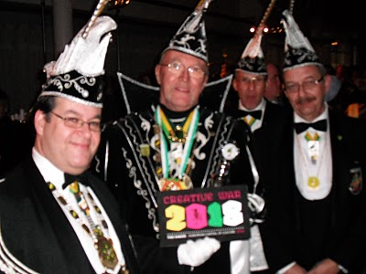
What’s wrong with
these men?

Slide 18
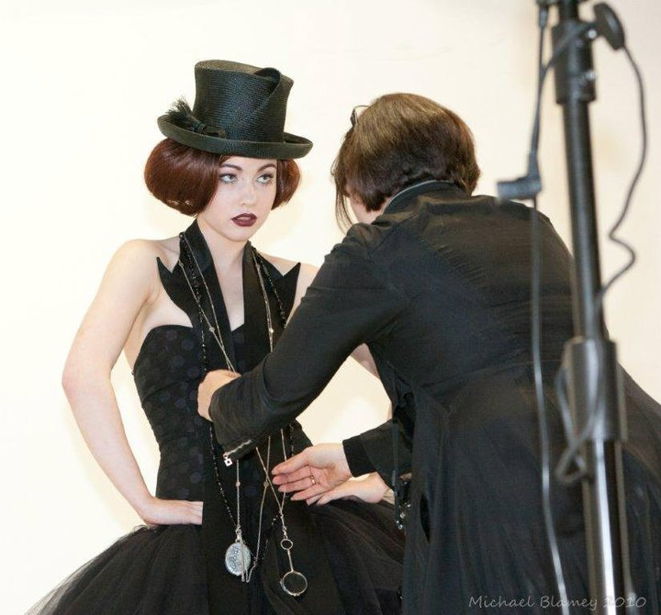
What’s wrong with
the woman in front?

Slide 19
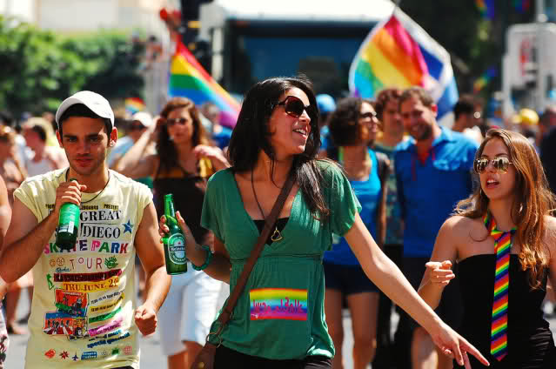
What’s wrong with
these people?

Slide 20
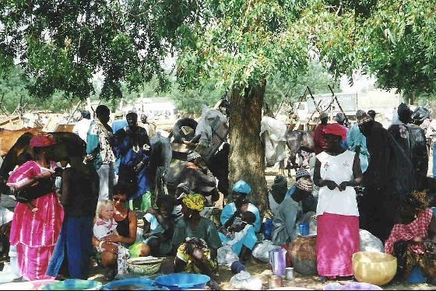
What’s wrong with
the little white girl?

Slide 21
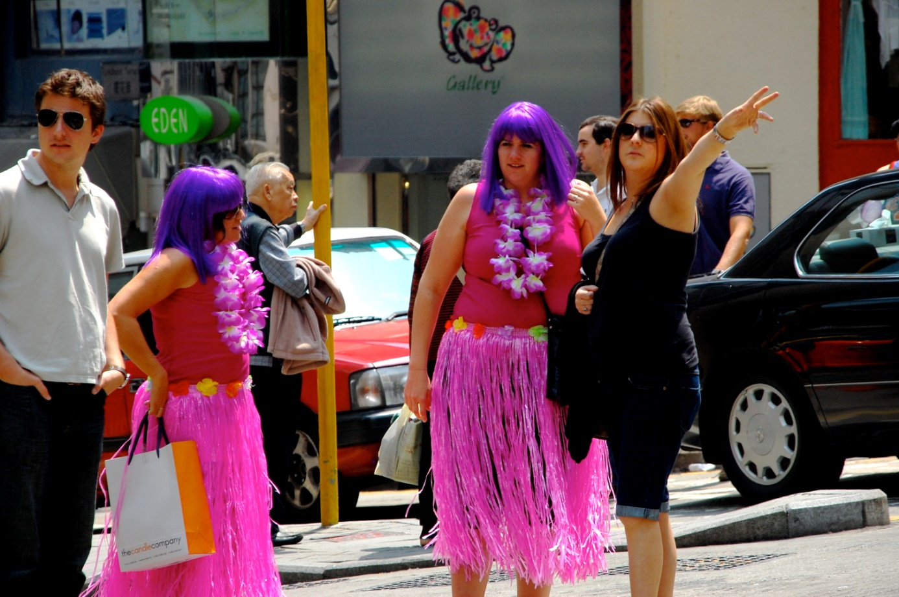
What’s wrong with
the man with sunglasses?

Slide 22
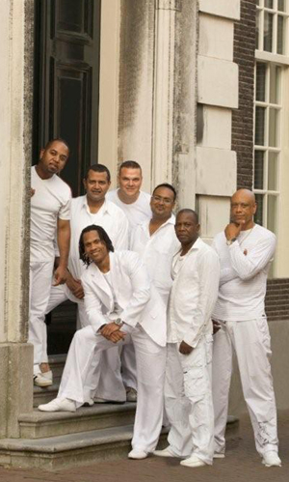
What’s wrong with
the man with long hair?

Slide 23
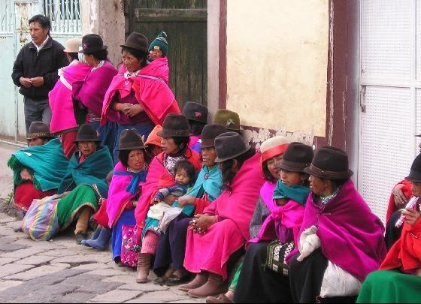
What’s wrong with
the person without a hat?

Slide 24
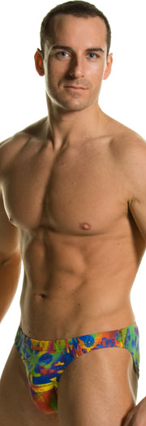
What’s wrong with
the man?

Slide 25
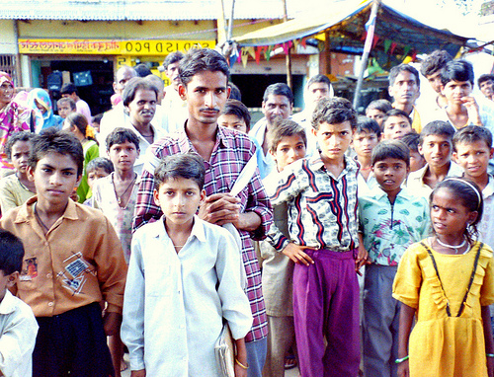
What’s wrong with
the young man holding his hand to his mouth?

Slide 26
What’s wrong with
the man wearing the striped suit?

Slide 27
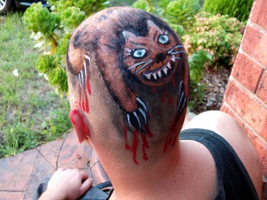
What’s wrong with
the woman?

Slide 28
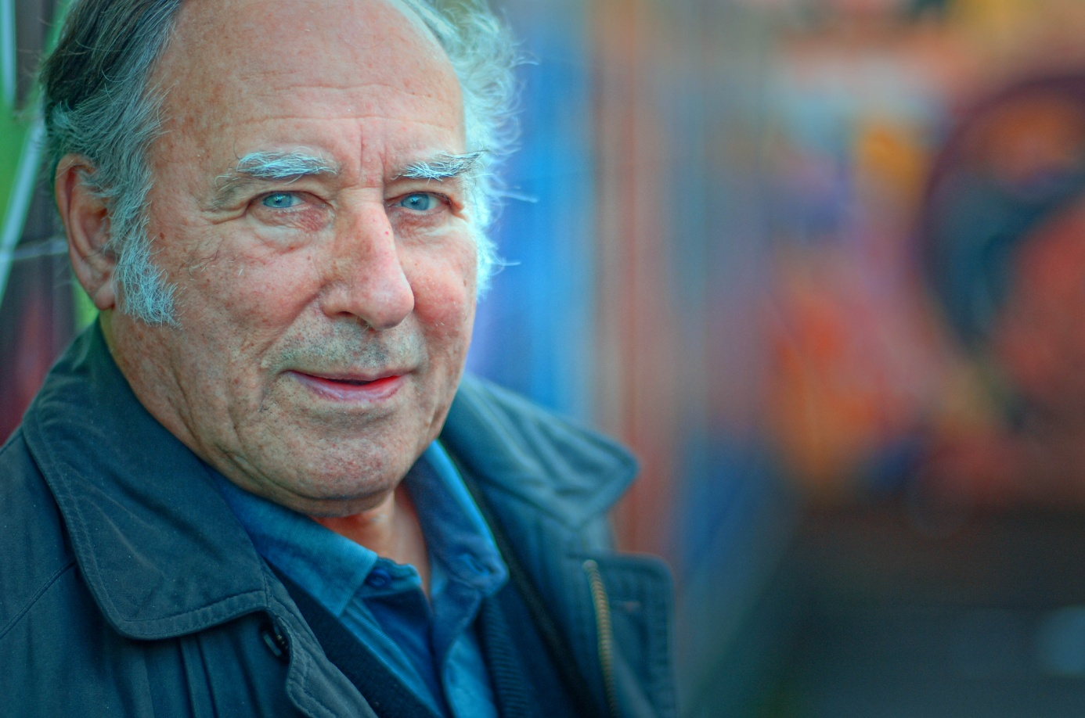
What’s wrong with
the man?

Slide 29
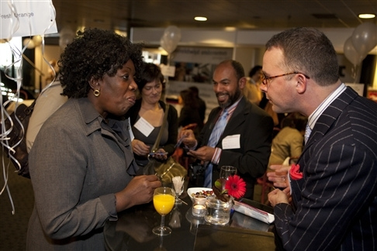
What’s wrong with
the man wearing the red pocket handkerchief?

Slide 30
What’s wrong with
the woman?

Slide 31
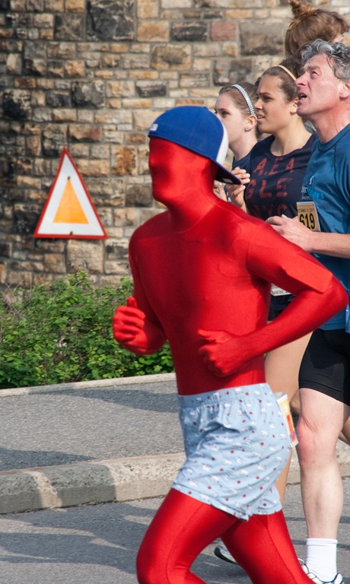
What’s wrong with
the man in front?

Slide 32
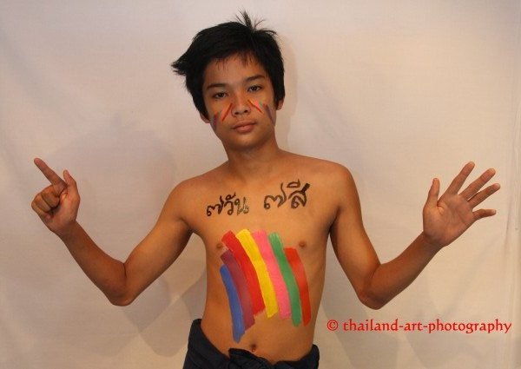
What’s wrong with
the boy?

Slide 33
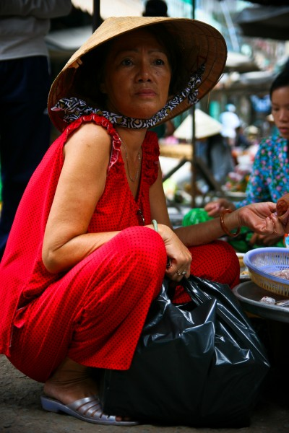
What’s wrong with
the woman at the back?

Slide 34
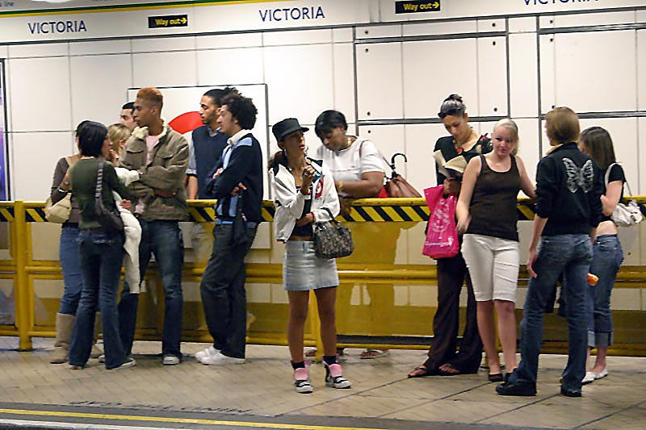
What’s wrong with
the young man with a butterfly on his pullover?

Slide 35
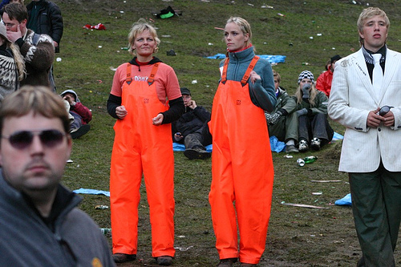
What’s wrong with
the girl holding her hand before her face?

Slide 36
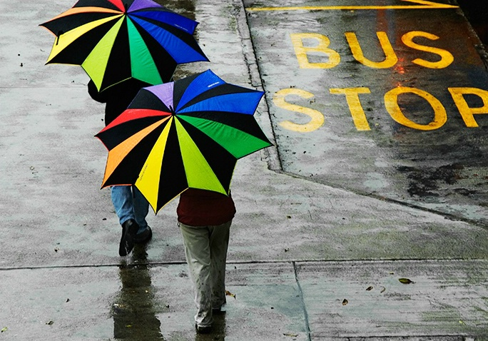
What’s wrong with
these persons?

Slide 37
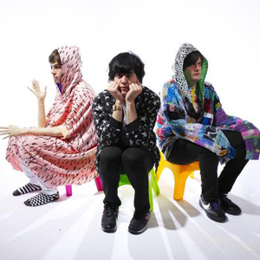
What’s wrong with
the young man in the middle?

Slide 38
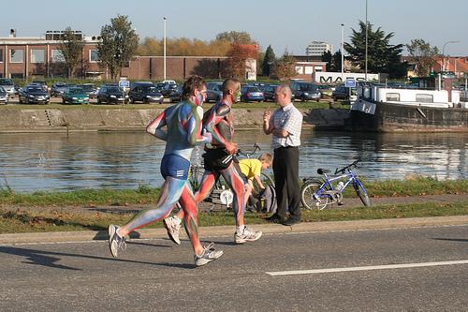
What’s wrong with
the man on the right?

Slide 39
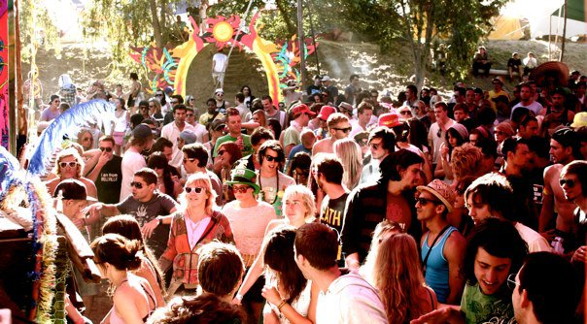
What’s wrong with
the man going away?

Slide 40
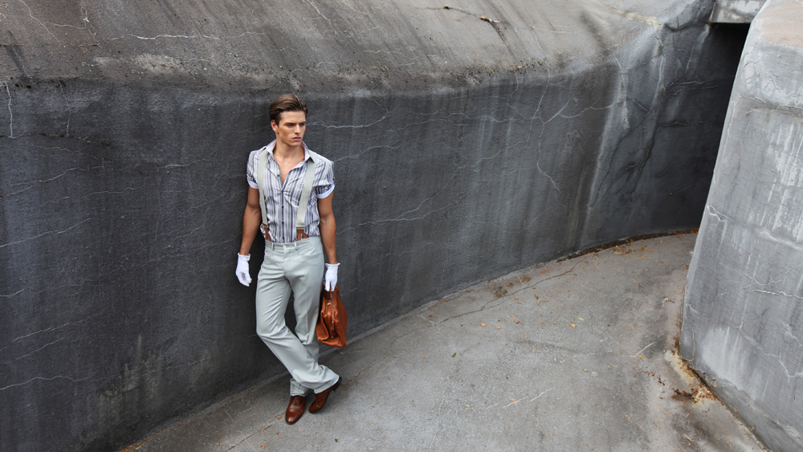
What’s wrong with
the man?

Slide 41
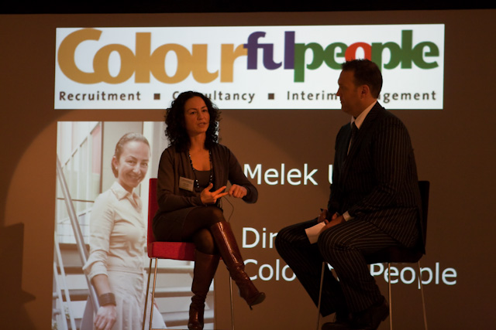
What’s wrong with
the woman on the photo at the back?

Slide 42
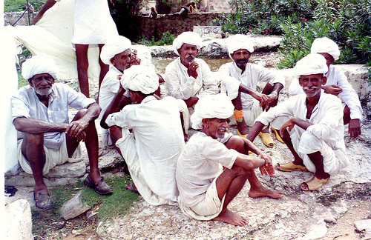
What’s wrong with
the person of whom you see only the lower part of the body?

Slide 43
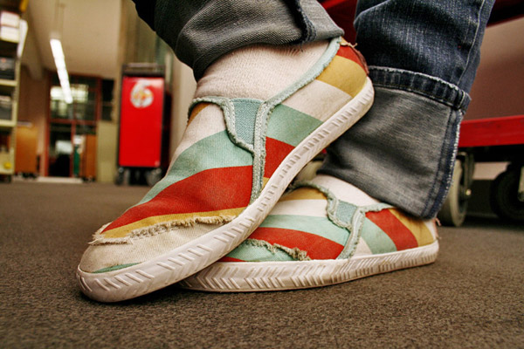
What’s wrong with
this person?

Slide 44
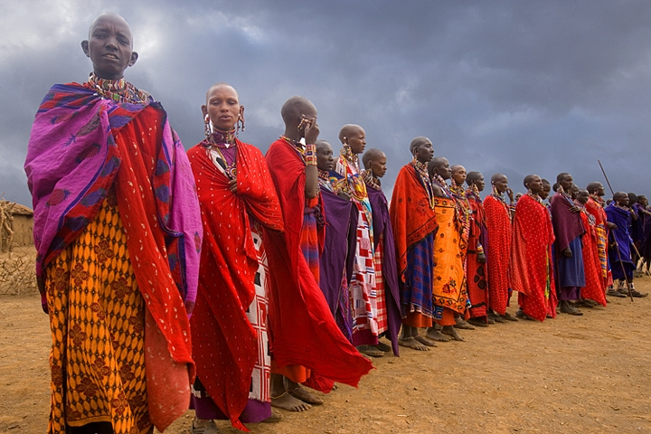
What’s wrong with
the person holding a spear?

Slide 45
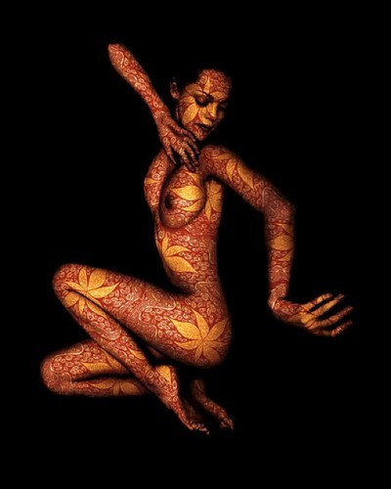
What’s wrong with
the woman?

Slide 46
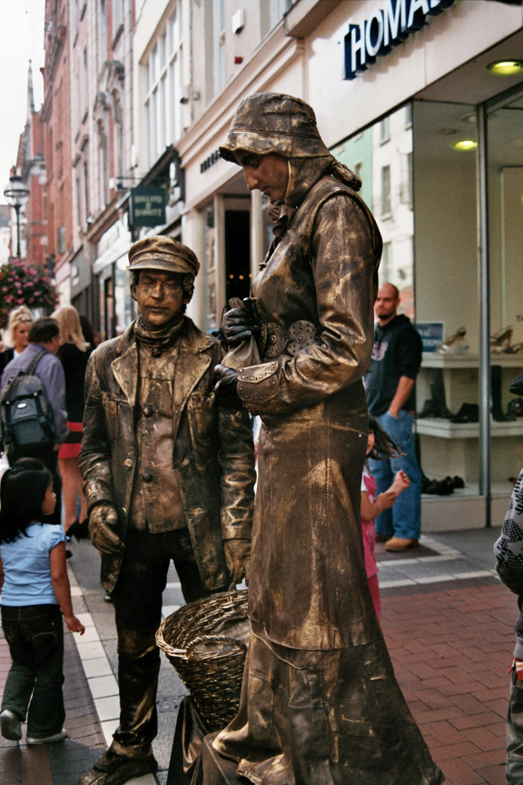
What’s wrong with
the man standing still?

Slide 47
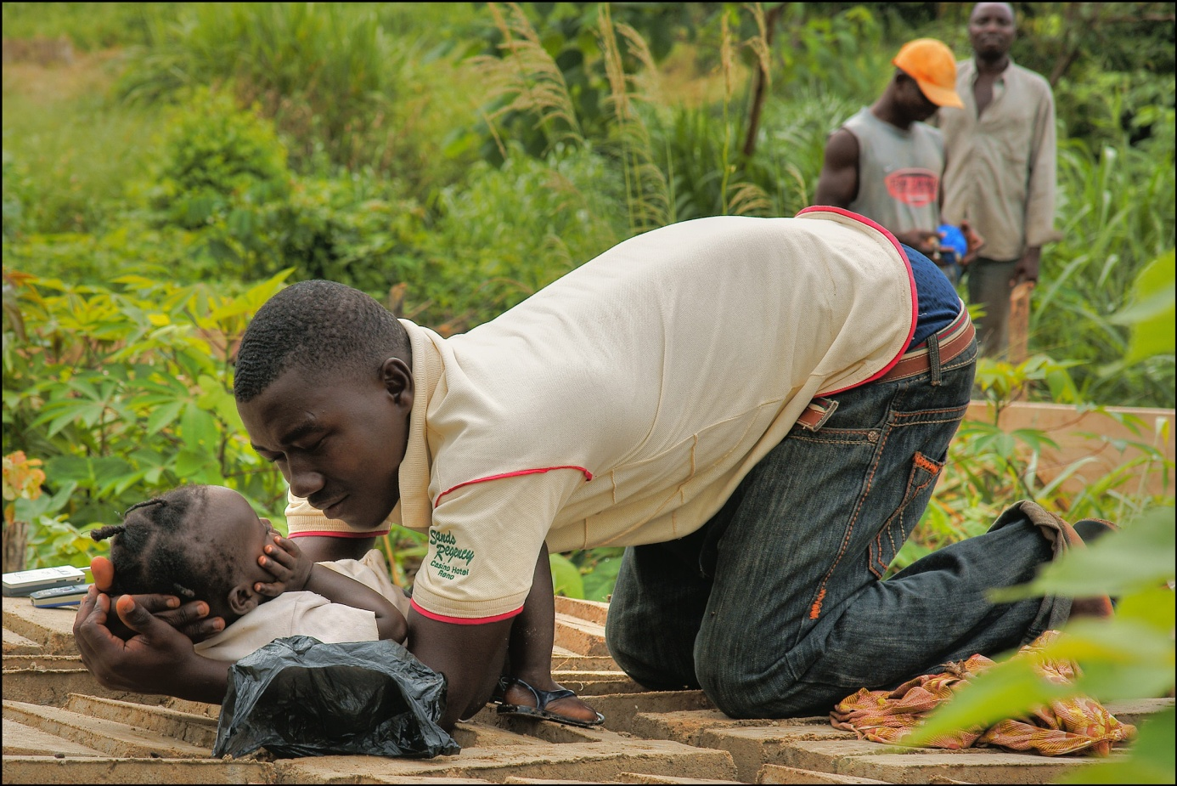
What’s wrong with
the man and the child?

Slide 48
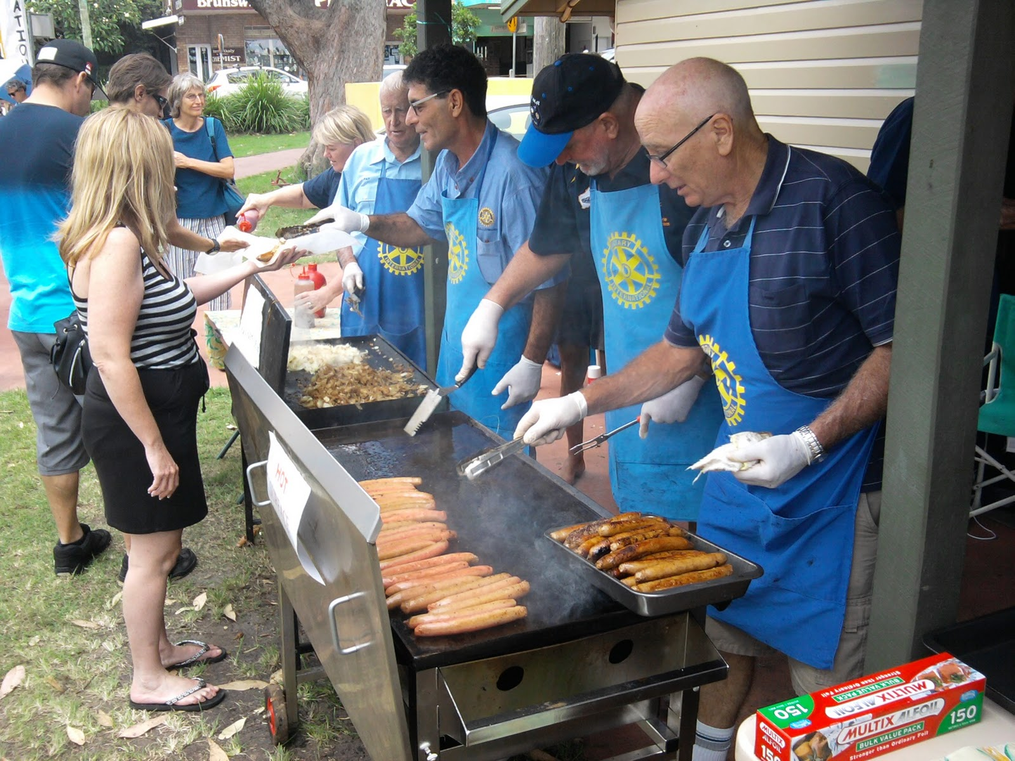
What’s wrong with
these men and women?

Slide 49
Are you sure
of all your answers?
Please, look at the photos
once again…

Slide 50
Are you sure
of all your answers?
Please, look at the photos
once again…

